Slide 1

Presentation on the Project Work Entitled
FAKE ACCOUNT DETECTION USING ANN BASED MODEL IN MACHINE LEANING
Submitted to the
Department of MCA
for the partial fulfilment of the requirements of the award of MCA Degree
Under the esteemed Guidance of
Ms. N. Pushpanjali
MCA
Assistant professor,
Department of MCA,
Bapatla Engineering College.
Presentation By
Ms. M. Lakshmi Durga
Regd.No:Y25MC23049
Class : II MCA
Semester: IV semester
Bapatla Engineering College.

Slide 2
Contents
1. Abstract.
2. Existing System.
3. Drawbacks in the existing system.
4. Proposed System.
5. Advantages of the proposed system.
6. Modules Description.
7. Software Requirements.
8. Hardware Requirements.
9. Algorithms used in the project.
10. About the Software.
11. Design of the Project

Slide 3
Contents(Contd..)
12. Implementation Details.
13. Sample Code.
14. Testing Stratagies Used.
15. Sample test cases.
16. Output Screens.
17. Conclusion and Future work.

Slide 4
Abstract
In today’s digital world, many fake accounts are created on online platforms. These fake accounts cause problems like cybercrime, misinformation, and online harassment. To solve this problem, this project develops a fake account detection system using machine learning. The system collects user data and prepares it for analysis. Important features are selected from the data. Machine learning algorithms are used to train the model. The model learns how to identify real and fake accounts. The system checks user activities continuously. When a fake account is found, administrators are alerted. This helps in taking quick and legal action. The accuracy of the system depends on good quality and enough data. The system improves over time to detect new fake account techniques

Slide 5
Existing System
1. Existing platforms mainly rely on manual verification and rule-based systems to detect fake accounts.
2.Traditional systems use static thresholds (e.g., number of posts, followers) for account validation.
3. Fake account detection is often performed after user complaints, not proactively.
4. Limited use of advanced machine learning techniques for behavioral analysis.
5. Existing solutions lack continuous monitoring and adaptive learning.
6. Attacks are often done through social media, emails, or links.
7. They also fail to detect harmful links and complex fake behaviors.

Slide 6
Drawbacks in the Existing System
The system has low accuracy in detecting fake accounts.
Fake accounts can manipulate their information to avoid detection
The system relies on traditional methods, which are outdated.
It cannot properly analyze user behavior and interactions.
Sometimes it gives wrong results (false positives or false negatives).

Slide 7
Proposed System
1. Proposes a machine learning–based fake account detection system.
2. Collects and preprocesses user profile, activity, and interaction data.
3. Performs feature engineering to extract behavioral and statistical patterns.
4. Trains ML classifiers (e.g., Random Forest, SVM, Logistic Regression) to distinguish real and fake accounts.
5. Deploys a real-time monitoring system that alerts administrators upon detection.
6. Finally, the system gives a result showing whether the account is genuine or fake.

Slide 8
Advantages of the proposed system
The system provides higher accuracy in detecting fake accounts.
It uses AI and machine learning techniques, which are more advanced than
traditional methods.
It analyzes user behavior and posts, making detection more reliable.
It uses multiple algorithms together, which improves performance.

Slide 9
Module Description
1. Admin Module
Admin logs into the system and manages the dataset and process.
Admin applies different algorithms and monitors prediction results.
2. ML Model Module
The model is trained and tested using user dataset information.
It identifies whether a user is a malicious bot or a normal user.
3. K-Nearest Neighbor (KNN) Module
It classifies data based on nearest neighbor values from the dataset.
The output is decided by the majority class among nearest data points.

Slide 10
4. Gaussian Naïve Bayes Module
It uses probability distribution to classify the data.
It assumes features are independent and follows normal distribution.
5. Logistic Regression Module
It uses a mathematical model to calculate probabilities.
It classifies the output into two categories: fake or real.
6. Ensemble Algorithm Module
It combines multiple machine learning models together.
It improves prediction accuracy compared to a single model.

Slide 11
Software Requirements
Operating System : Windows XP / 7 / 10
Development Framework : Flask framework
Programming Language : Python
Dataset : Twitter dataset
IDE (Development Tool) : Anaconda Prompt

Slide 12
Hardware requirements
System/Processor : Pentium IV 2.4 GHz
Hard Disk : 100 GB
RAM : 4 GB
Monitor : 15-inch VGA Color Monitor
Input Device : Mouse (Logitech)

Slide 13
Algorithms used in the project
1. K-Nearest Neighbors(KNN) Algorithm
Explanation and purpose:
KNN classifies a new account based on the similarity with nearby data points.
To identity whether an account is fake or real by comparing it with similar
profiles.
Algorithm Steps:
Load the dataset (user profiles/tweets)
Select the value of K
Calculate distance between test data and all training data
Identify the K nearest neighbors
Count the class labels of neighbors
Assign the class with majority vote (Fake/Real)

Slide 14
2. Gaussian Naïve Bayes(GNB) Algorithm
Explanation and Purpose:
A probability-based algorithm that uses Bayes theorem and assumes features are independent.
To quickly predict fake accounts using probability and handle large datasets efficiently.
Algorithm Steps:
Load and preprocess dataset
Calculate prior probability of each class
Compute mean and variance of features for each class
Apply Bayes Theorem
Calculate probability of each class for input data
Choose the class with highest probability

Slide 15
3. Logistic Regression(LR)
Explanation and Purpose:
A statistical algorithm used for binary classification(0 0r 1).
To predict whether an account is fake(1) or real(0) with high accuracy.
Algorithm Steps
Load dataset
Initialize weights (parameters)
Apply sigmoid function to calculate probability
Compute loss (error)
Update weights using optimization method
Predict output (0 = Real, 1 = Fake)

Slide 16
4. Ensemble Algorithm
Explanation and Purpose:
Combines multiple algorithms to make a final prediction.
To improve overall accuracy and performance of fake account detection.
Algorithm steps:
Train multiple models (KNN, NB, LR)
Get predictions from each model
Combine predictions (voting/averaging)
Produce final result
Evaluate using accuracy, precision, recall

Slide 17
About the Software
Python
Python is the main programming language used to build the system. It helps in developing machine learning models and processing data. It also supports useful libraries like NumPy, Pandas, and Scikit-learn for analysis.
Anaconda
Anaconda is used to manage Python environments and packages. It makes it easy to install all required libraries for machine learning. It also provides Jupyter Notebook for testing and experimenting with code.

Slide 18
Flask
Flask is used as the backend framework of the project. It handles application logic like user requests, authentication, and routing. It connects the machine learning model with the web interface.
MySQL
MySQL is used to store data in the system. It keeps user details, datasets, and prediction results safely. It ensures structured and secure data management.

Slide 19
Design of the Project
System Architecture
Use case diagram
Class diagram
Sequence diagram
Activity diagram
Component diagram
Deployment diagram

Slide 20
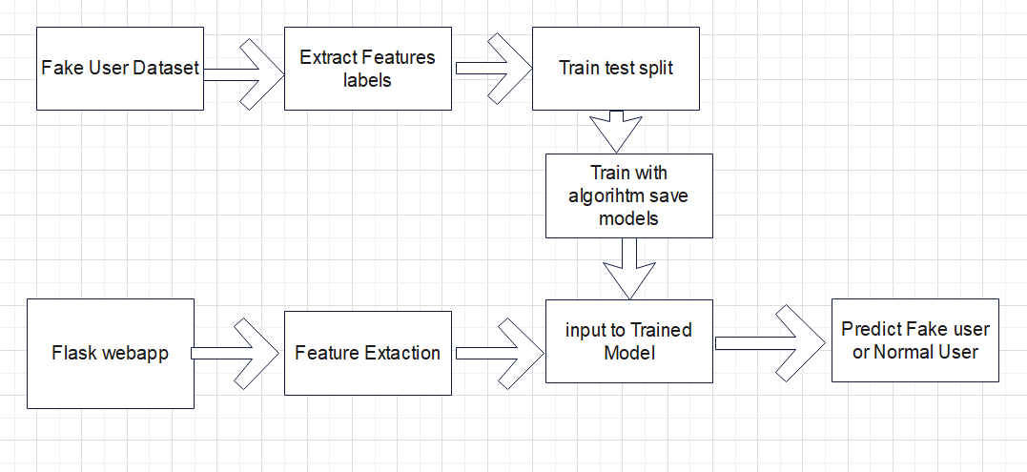
System Architecture

Slide 21
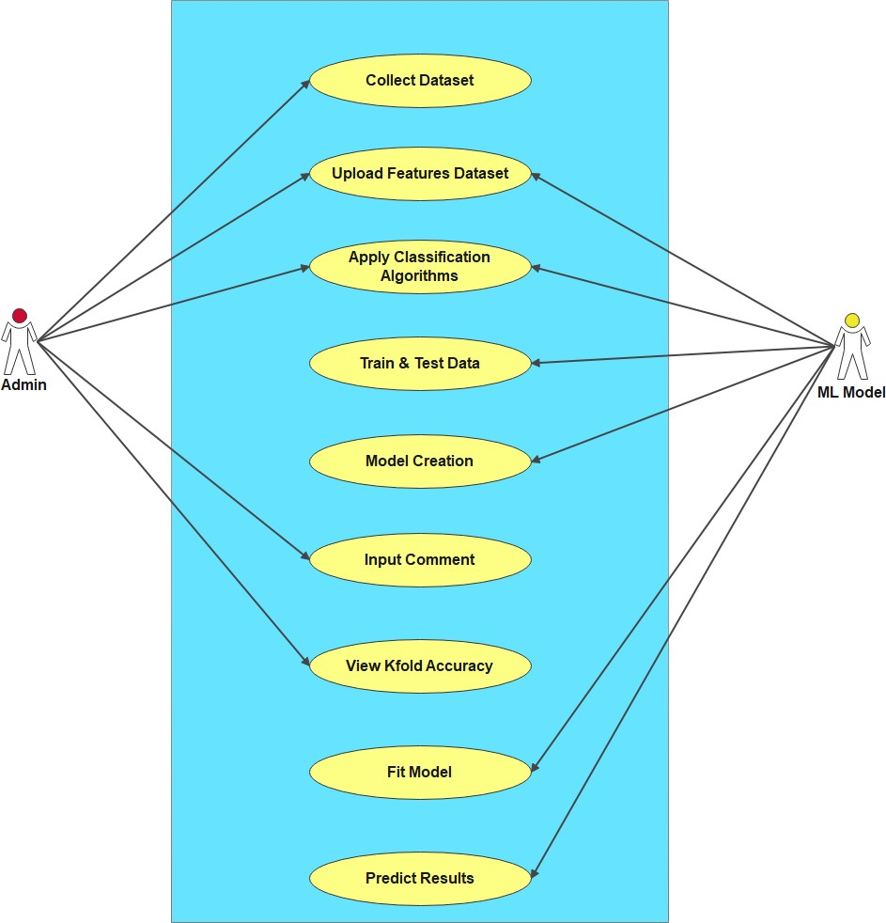
Use Case diagram

Slide 22
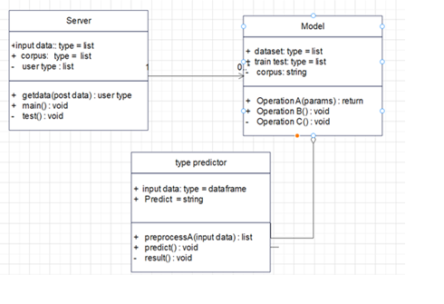
Class diagram

Slide 23
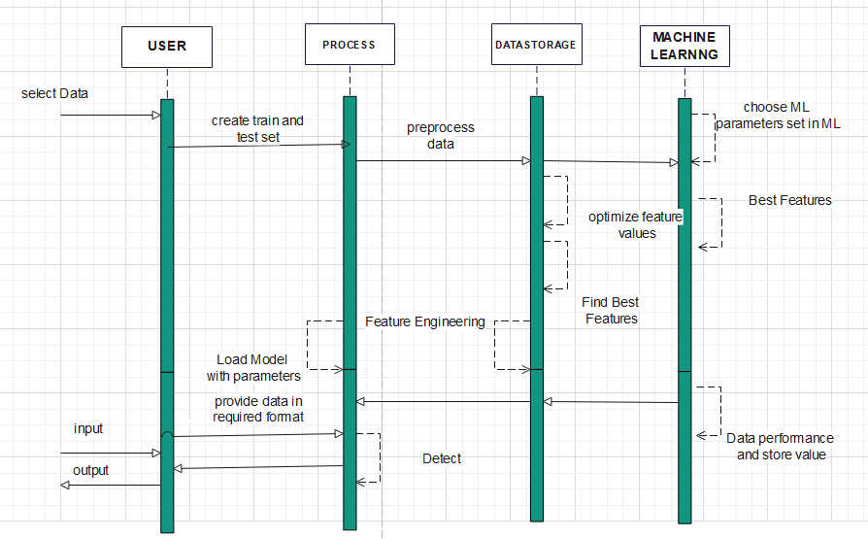
Sequence diagram

Slide 24
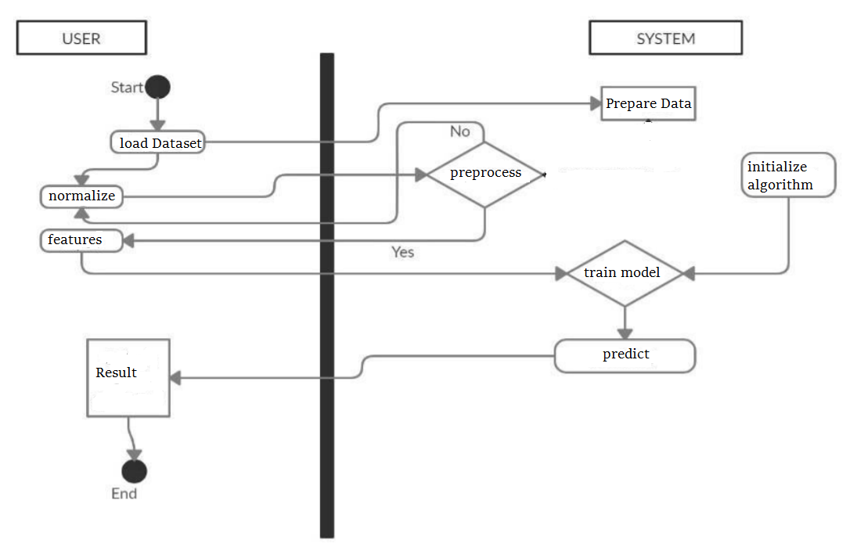
Activity diagram

Slide 25
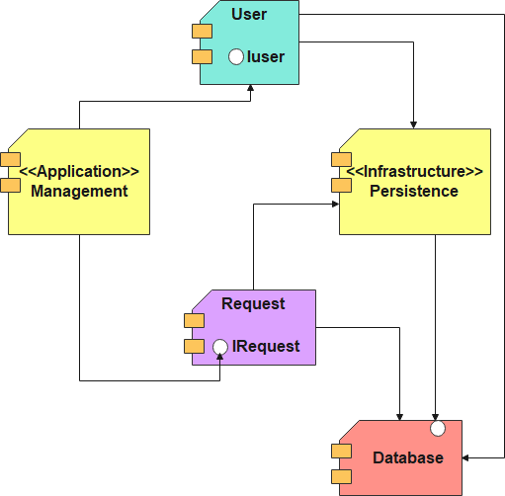
Component diagram

Slide 26
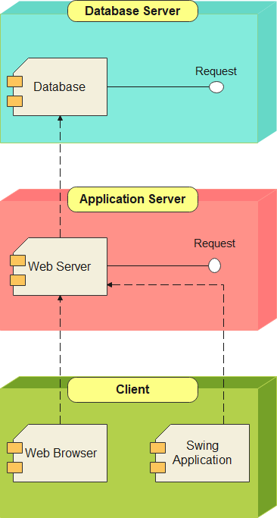
Deployment diagram

Slide 27
Implementation Details
Dataset Upload
Twitter dataset is loaded into the system
Preprocessing
Removes noise, unwanted symbols, missing values
Cleans text data
Feature Extraction
Extracts important features like:
URL characteristics
tweet content
user behavior

Slide 28
Training Models
Data is split into training and testing sets
Algorithms are trained using training data
Prediction
Test data is used to predict fake or real accounts
Evaluation
Accuracy is measured using:
Precision
Recall
F1-score
Cross-validation

Slide 29
Sample code
# Import Libraries import numpy as np import pandas as pd # Preprocessing from sklearn.model_selection import train_test_split from sklearn.preprocessing import StandardScaler # ML Algorithms from sklearn.linear_model import LogisticRegression from sklearn.ensemble import RandomForestClassifier # Evaluation from sklearn.metrics import accuracy_score, classification_report # ANN (Deep Learning) from tensorflow.keras.models import Sequential from tensorflow.keras.layers import Dense # Load Dataset (example CSV file) data = pd.read_csv("fake_account_dataset.csv")

Slide 30
# Features and Labels X = data.drop("label", axis=1) # Features y = data["label"] # 0 = Real, 1 = Fake # Split Data (80% train, 20% test) X_train, X_test, y_train, y_test = train_test_split(X, y, test_size=0.2, random_state=42) # Feature Scaling scaler = StandardScaler() X_train = scaler.fit_transform(X_train) X_test = scaler.transform(X_test) # ------------------------------- # 1. Logistic Regression Model # ------------------------------- lr_model = LogisticRegression() lr_model.fit(X_train, y_train) lr_pred = lr_model.predict(X_test) print("Logistic Regression Accuracy:", accuracy_score(y_test, lr_pred)) print(classification_report(y_test, lr_pred))

Slide 31
# 2. Random Forest Model # ------------------------------- rf_model = RandomForestClassifier() rf_model.fit(X_train, y_train) rf_pred = rf_model.predict(X_test) print("Random Forest Accuracy:", accuracy_score(y_test, rf_pred)) # ------------------------------- # 3. ANN Model (Based on Document) # ------------------------------- ann_model = Sequential() # Input + Hidden Layers ann_model.add(Dense(units=16, activation='relu', input_dim=X_train.shape[1])) ann_model.add(Dense(units=8, activation='relu')) # Output Layer ann_model.add(Dense(units=1, activation='sigmoid')) # Compile Model ann_model.compile(optimizer='adam', loss='binary_crossentropy', metrics=['accuracy'])

Slide 32
# Train Model ann_model.fit(X_train, y_train, epochs=20, batch_size=32) # Evaluate Model loss, acc = ann_model.evaluate(X_test, y_test) print("ANN Accuracy:", acc) # ------------------------------- # 4. Prediction Example # ------------------------------- sample_input = X_test[0].reshape(1, -1) prediction = ann_model.predict(sample_input) if prediction > 0.5: print("Fake Account") else: print("Real Account")

Slide 33
Testing Stratagies used
Test Case Testing
Test cases are used to check each function like data upload, preprocessing, and prediction.
It ensures that every part of the system works correctly.
Performance Testing
The model is evaluated using accuracy, precision, recall, and F1-score.
It helps to measure how well the system detects fake accounts.

Slide 34
Cross Validation Testing
The system uses 10-fold cross validation to test the model multiple times.
It improves reliability and avoids overfitting.
Confusion Matrix Testing
It checks prediction results using TP, TN, FP, and FN values.
It helps to understand errors and correctness of the model.

Slide 35
Test cases
Test Case Id | Test Case Name | Test Case Desc. | Test Steps |  |  | Test Case Status | Test Priority
 |  |  | Step | Expected | Actual
01 | Upload the tasks dataset | Verify either file is loaded or not | If dataset is not uploaded | It cannot display the file loaded message | File is loaded which displays task waiting time | High | High

Slide 36
02 | Upload live video | Verify either dataset loaded or not | If dataset is not uploaded | It cannot display dataset reading process completed | It can display dataset reading process completed | low | High
03 | Preprocess ing | Whether preprocessing on the dataset applied or not | If not applied | It cannot display the necessary data for further process | It can display the necessary data for further process | Medium | High
04 | Prediction Multi model Naive Bayes model | Whether Prediction algorithm applied on the data or not | If not applied | Multi model Naive Bayes model is created | Multi model Naisve Bayes model is created | High | High

Slide 37
05 | Prediction | Whether predicted data is displayed or not | If not displayed | It cannot view prediction containing bot tweet data | It can view prediction containing bot tweet | High | High
06 | Noisy Records Chart | Whether the graph is displayed or not | If graph is not displayed | It does not show the variations in between clean and noisy records | It shows the variations in between clean and noisy records | Low | Medium

Slide 38

Output Screens Main page

Slide 39

Login Page

Slide 40
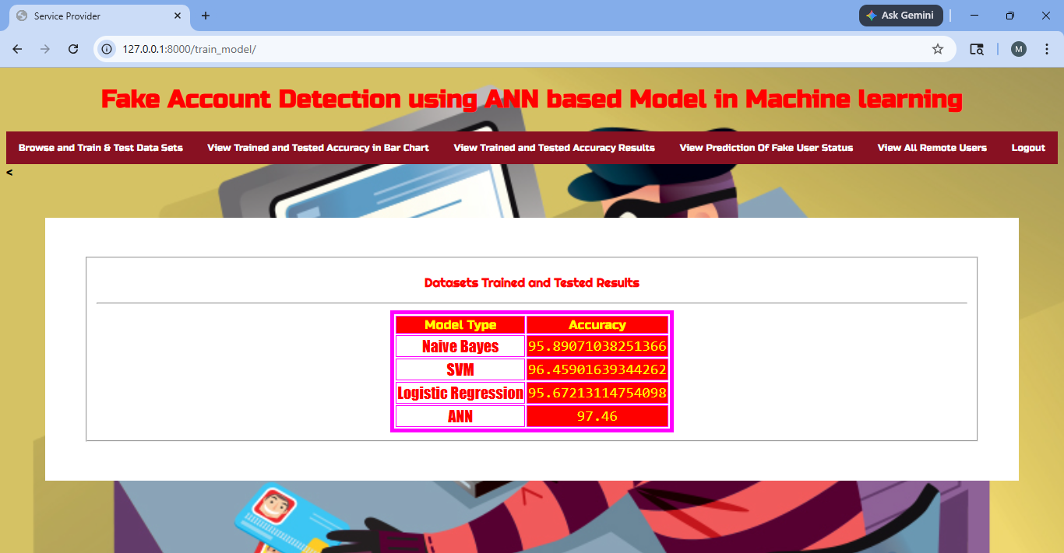

Slide 41
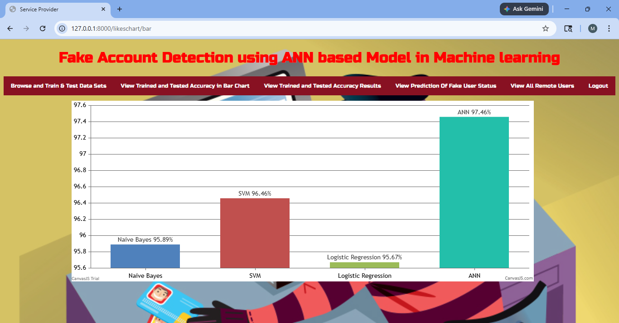
Accuracy bar graph

Slide 42
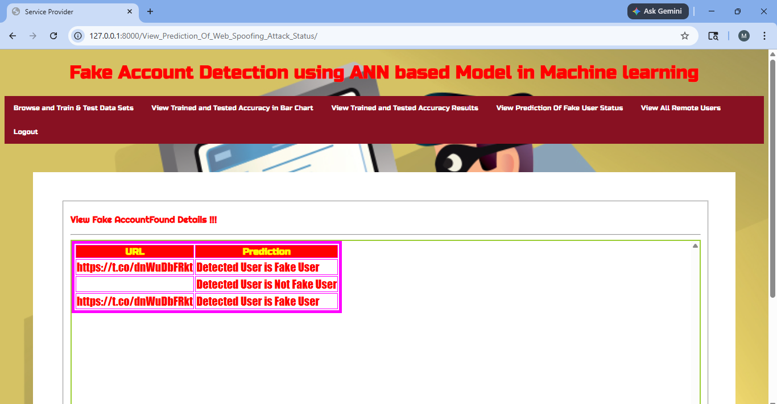

Slide 43
Conclusion
The project successfully detects fake social media accounts using machine
learning techniques.
Algorithms like KNN, Naïve Bayes, Logistic Regression, and Ensemble methods improve classification accuracy.
The system uses Python and Flask to build an efficient and user-friendly application.
Data preprocessing and feature extraction help in achieving better prediction results.
Overall, the system enhances security by identifying fake profiles and reducing harmful activities on social media platforms.

Slide 44
Future work
Introduce unique user identification (such as Aadhaar linking) to ensure one
account per user and reduce fake profiles.
Improve the system accuracy by applying advanced machine learning and deep learning techniques.
Extend the system to work across multiple social media platforms for wider detection.
Implement real-time detection to identify fake accounts instantly and improve system efficiency.

